Slide 1

Training robust neural networks
BENMANSOUR Adnan - BOUSKILA Laurène - CASTRO ROS Alejandro

Slide 2
Problem Definition
Objective:
Add small perturbations to fool the classification system (attack).
Implement strategies to avoid these attacks (defense).
Dataset: CIFAR10
60,000 images (50K-10K train-test split) belonging to 10 different classes.
Base model:
Add Dropout and used SGD with learning-rate scheduler to optimize classification.
Data Normalization and Augmentation (horizontal flip and random crops) on training data.
Obtained accuracy of 87.75% over test data.

Slide 3
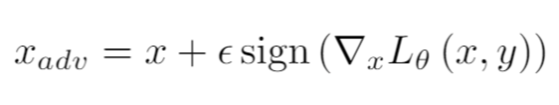
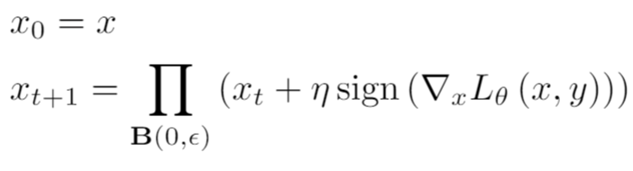
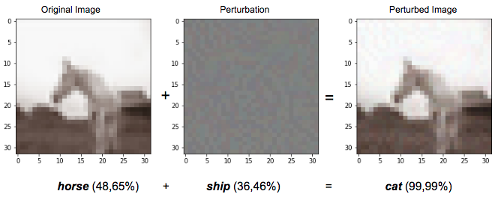
Attacks: FGSM v/s PGD
FGSM
Perturbations on the gradient direction.
Constrained amplitude to make imperceptible perturbations.
PGD is an iterative version of the FGSM.
PGD

Slide 4
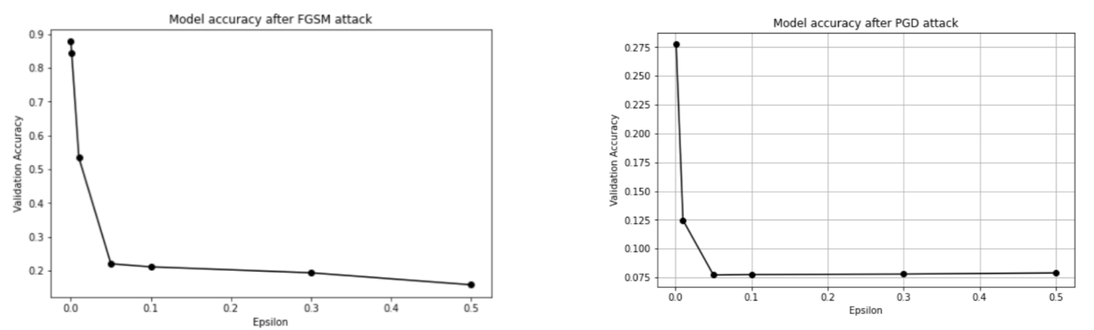
Attacks: FGSM v/s PGD

Slide 5
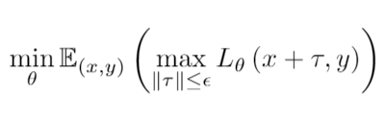
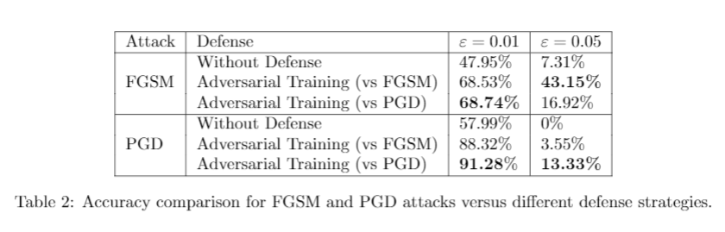
Adversarial Training Defense
Defense system that aims at improving neural network robustness against adversarial attacks by training it with adversarial examples.
Notes:
Lis the adversarial loss
with parameters θ
x is the adversarial input
y is the ground truth label
τ is the perturbation

Slide 6
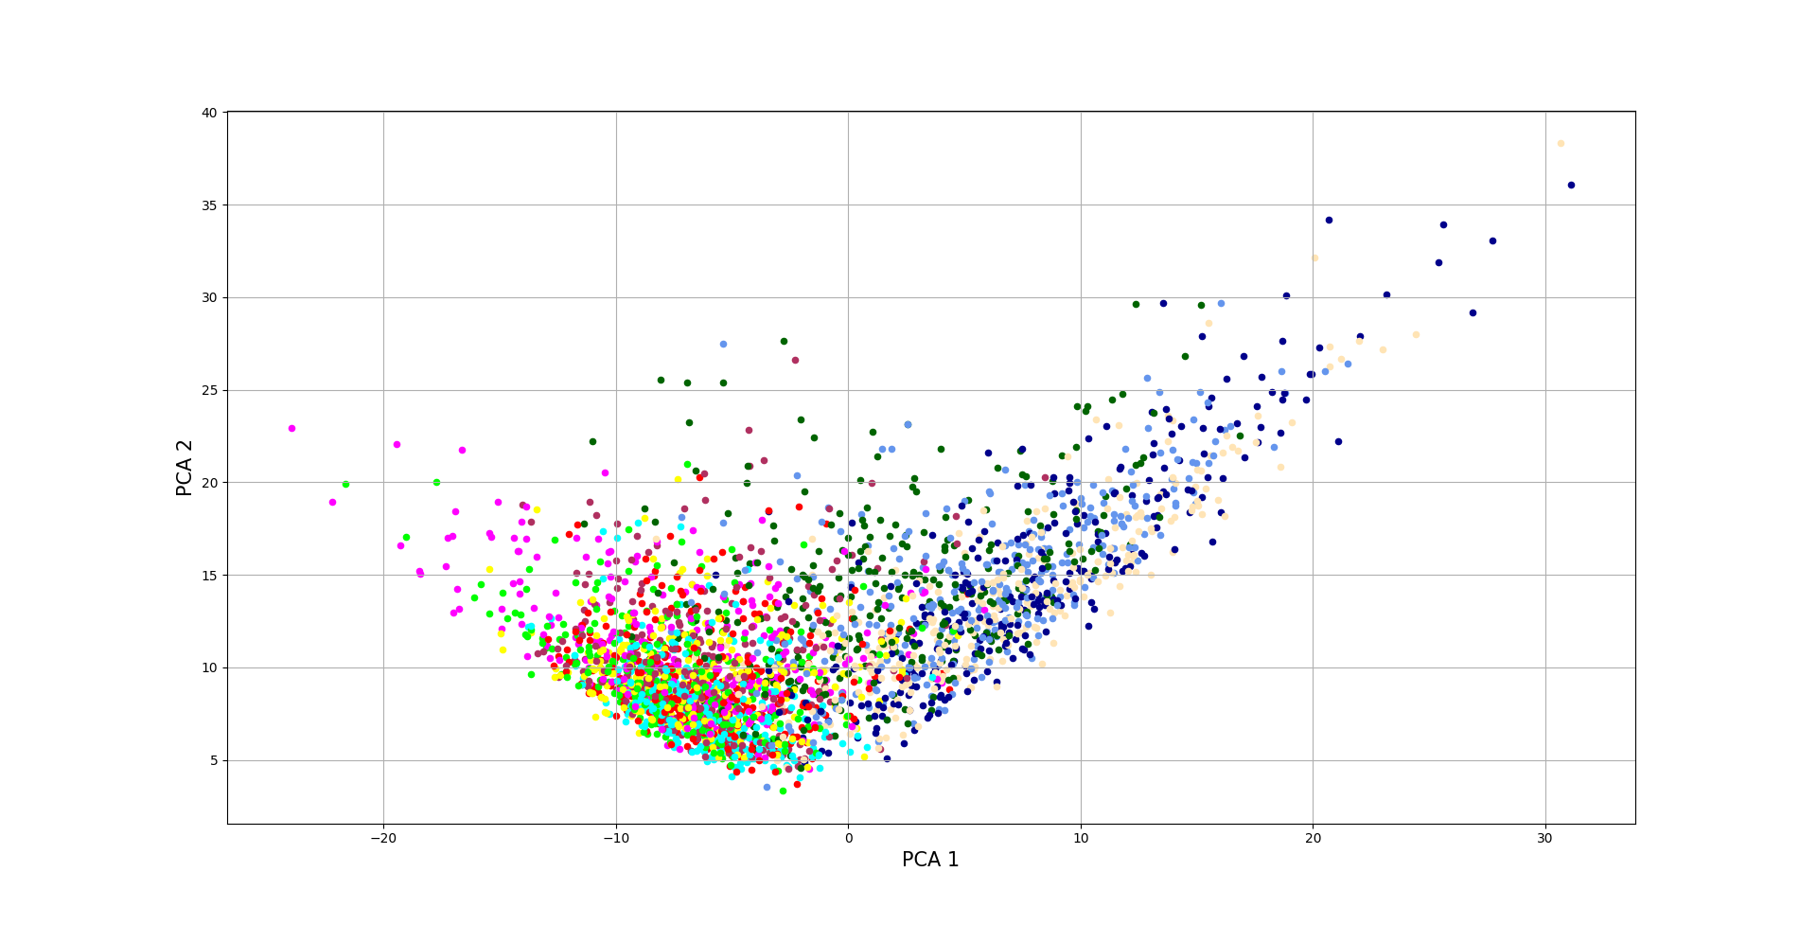
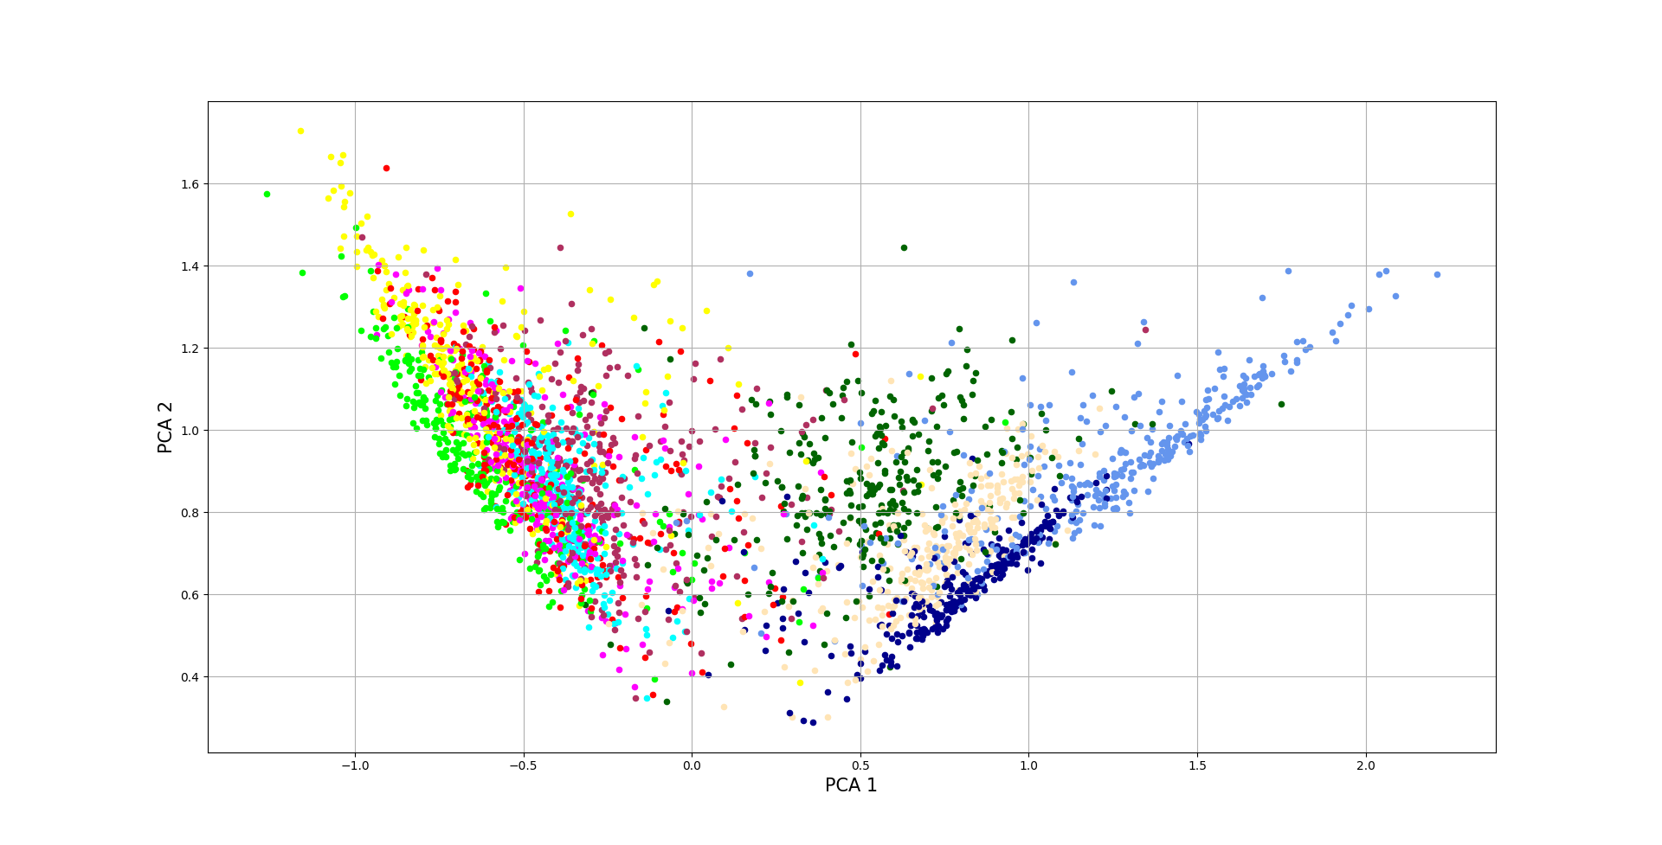
Defense based on contrastive loss
Possible defense: create clusters in the feature space, so that a small perturbation won’t lead to misclassification.
This is enabled by the use of contrastive loss.
PCA without defense
PCA with contrastive loss applied

Slide 7
Conclusions
PGD attack is more powerful than FGSM attack since it computes a new perturbation at each iteration to fool the misclassification.
Adversarial defense improves the robustness of the model, but it’s still prone to fail.
Defense system built on the contrastive loss principle:
lower accuracy than adversarial training
need further work on this defense system

Slide 8
Merci pour votre attention

